Slide 1

CSE- 104
Structured Programming Lab
Lab : 04 Array & Function
Fahad Ahmed
Lecturer, Dept. of CSE
E-mail: fahadahmed@uap-bd.edu

Slide 2
Exercise
C program to insert element in array at given position.
Input
Input array elements: 10, 20, 30, 40, 50
Input element to insert: 35
Input position where to insert: 3
Output
Elements of array are: 10, 20, 30,35, 40, 50

Slide 3
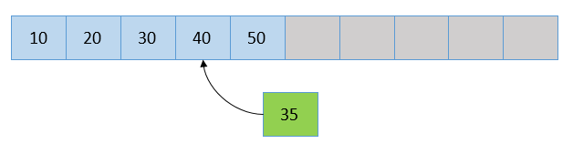
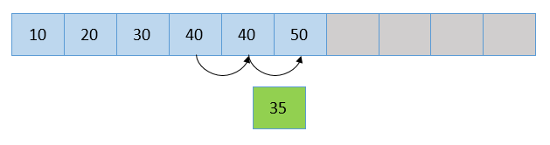
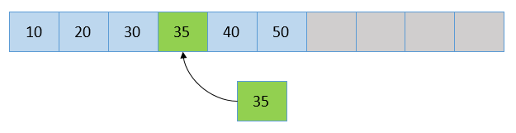
Exercise
C program to insert element in array at given position.
N=3
Pos=2

Slide 4
C Functions
A function is a block of code that performs a specific task.
Types of function
There are two types of function in C programming:
Standard library functions
User-defined functions

Slide 5
C Functions
Standard library functions
The standard library functions are built-in functions in C programming.
These functions are defined in header files.
For example,
printf()
sqrt()

Slide 6
C Functions
Square root using sqrt() function
#include <stdio.h>
#include <math.h>
int main()
{
float num, root;
printf("Enter a number: ");
scanf("%f", &num);
root = sqrt(num);
printf("Square root of %.2f = %.2f", num, root);
return 0;
}

Slide 7
C Functions
User-defined function
You can also create functions as per your need.
Such functions created by the user are known as user-defined functions.
returntype functionName(type1 parameter1, type2 parameter2,...);
int multiply (int a, int b);

Slide 8
C Functions
User-defined function
Calling a function
When a function is called, control of the program gets transferred to the function.
function_Name();
or
function_Name(argument1, argument2,...);
In the example above, the statement
Show();
multiply(i, j);

Slide 9
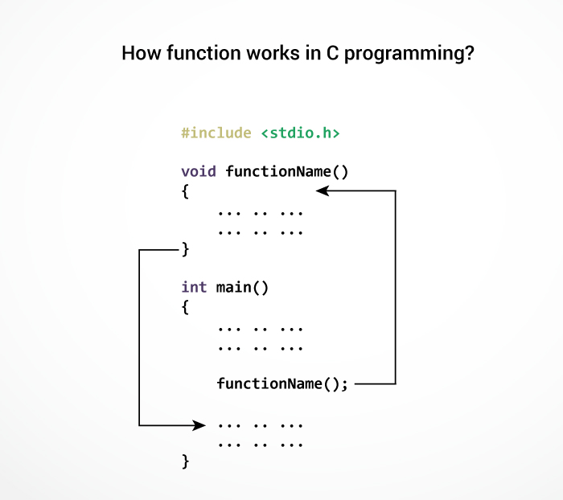
C Functions
Function
Definition
Function
Calling
Function
Prototype

Slide 10
C Functions
#include<stdio.h>
void show()
{
printf("This is from function \n");
}
int main()
{
printf(" it is main code\n\n");
show();
}

Slide 11
C Functions
#include<stdio.h>
void show()
{
printf("This is from function \n");
}
int main()
{
printf(" it is main code\n\n");
show();
printf(" Back in main function code\n\n");
show();
}

Slide 12
C Functions
#include<stdio.h>
void review()
{
printf("This is from review \n\n");
}
void show()
{
printf("This is from show \n");
review();
printf("Back to show \n");
}
int main()
{
printf(" it is main code\n\n");
show();
printf(" Back in main function code\n\n");
}
Review
Show
Main

Slide 13
C Functions
Program to find maximum between two numbers using functions

Slide 14
C Functions
#include <stdio.h>
int main()
{
int num1, num2, maxx;
printf("Enter two numbers: ");
scanf("%d%d", &num1, &num2);
if(num1 > num2)
maxx = num1;
else
maxx = num2;
printf("%d is maximum.", maxx);
return 0;
}
#include <stdio.h>
void maximum (int num1, int num2)
{
int maxx;
if(num1 > num2)
maxx = num1;
else
maxx = num2;
printf("%d is maximum.", maxx);
}
int main()
{
int num1, num2, max;
printf("Enter two numbers: ");
scanf("%d%d", &num1, &num2);
maximum (num1, num2);
return 0;
}

Slide 15
C Functions
#include<stdio.h>
void show()
{
printf("This is from function \n");
}
int main()
{
printf(" it is main code\n\n");
int i;
for(i=1; i<=3; i++)
{
show();
printf(" Back in inside loop when i= %d \n\n",i);
}
printf(" \nBack in main function code\n\n");
}

Slide 16
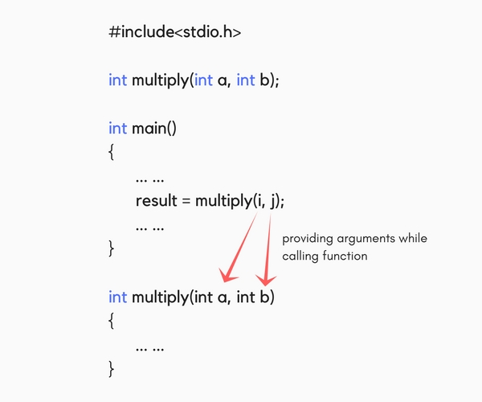
C Functions

Slide 17
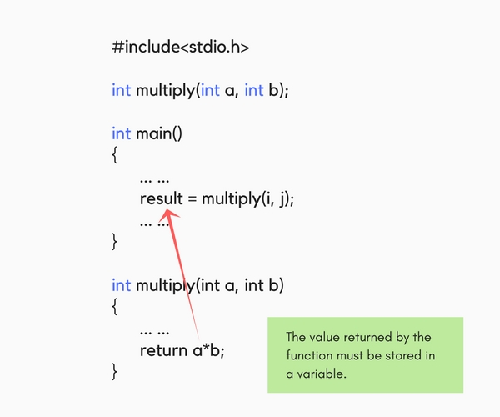
C Functions

Slide 18
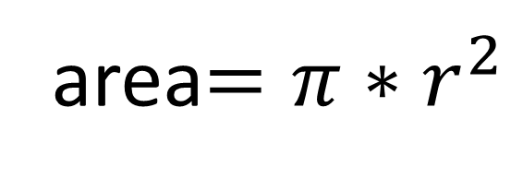
Class work
Write a c program to implement the equation using user define function. Where pi=3.1416
area$=π∗r^{2}$

Slide 19
Passing arrays to functions
#include <stdio.h>
int calculateSum(int arr[])
{
int sum = 0;
for (int i = 0; i < 10; ++i)
sum += arr[i];
return sum;
}
int main()
{
int result, arr[] = {1,2,3,4,5,6,7,8,9,10};
result = calculateSum(arr);
printf("Result = %d", result);
return 0;
}

Slide 20
Task
Write a program in C to check a given number is even or odd using the function.
Write a program in C to swap two numbers using function.
Global variable
Call by value
Call by reference
Recursive function

Slide 21
C - Scope Rules
A scope in any programming is a region of the program where a defined variable can have its existence and beyond that variable it cannot be accessed.
Inside a function or a block which is called local variables.
Outside of all functions which is called global variables.

Slide 22
Local Variables
#include <stdio.h>
int main () {
/* local variable declaration */
int a=10, b=20;
int c;
c = a + b;
printf ("value of a = %d, b = %d and c = %d\n", a, b, c);
return 0;
}

Slide 23
Global Variables
#include <stdio.h>
int c;// global
int sum(int num1, int num2)
{
c=num1+num2;
}
int main ()
{
/* local variable declaration */
int a=10, b=20;
c=sum(a,b);
printf ("value of a = %d, b = %d and c = %d\n", a, b, c);
return 0;
}

Slide 24
Call by value vs Call by reference

Slide 25
Call by value
#include <stdio.h>
void swap (int a, int b)
{
int temp;
temp = a;
a=b;
b=temp;
printf("In Swap function: a = %d, b = %d\n\n",a,b);
}
int main()
{
int a = 10;
int b = 20;
printf("Before swapping in main a = %d, b = %d\n\n",a,b);
swap(a,b);
printf("After swapping in main a = %d, b = %d\n",a,b);
}

Slide 26
Call by Reference
#include <stdio.h>
void swap (int *a, int *b)
{
int temp;
temp = *a;
*a=*b;
*b=temp;
printf("In Swap function: a = %d, b = %d\n\n",*a,*b);
}
int main()
{
int a = 10;
int b = 20;
printf("Before swapping in main a = %d, b = %d\n\n",a,b);
swap(&a,&b);
printf("After swapping in main a = %d, b = %d\n",a,b);
}

Slide 27
Quiz-02
Quiz: Next-week lab time
Function + Array

Slide 28

Thanks to All

